Slide 1


Guidance for Measuring Copilot Adoption and Clarifying Impact
*For more details see the Copilot Value Explainer.
Notes:
Welcome, These slides are meant to create some guide rails for both evaluations and planning the adoption of Copilot.
The focus is on Business Value (which varies by customers and can be elusive to measure). Hopefully, the approach recommended herein will help!

Slide 2




What we will Cover...
Quick Basics to help you make the best case for GitHub Copilot
VALUE CREATION
VALUE MODELING
MEASUREMENT
HOW NOT TO MEASURE
How does GitHub Copilot Create Value?
What can be expected from Adopting Copilot?
How should Copilot Value be measured?
What are Some Pitfalls to Avoid?

Slide 3
There is a growing number of metaphors for how to think 🤔 about GitHub Copilot….
As a CoPilot 👩🏽‍✈️🧑🏻‍✈️
As Expert System 👨🏾‍🏫
As Translator 👓🩻
As Communication Network 📡
As Predictive Model 🔮

Slide 4
Speeding up Dev Task Completion is where to start measuring…
Development Task Completion ⏱️
New Skill Acquisition & Expanding Developer impact via collaboration🫱🏼‍🫲
Onboarding to a new team or technology (or language) 🤓
Updating Documentation, Tests, and Automation 🧹
Finding Defects and avoiding Incidents 🦺
Notes:
Therefore, there is a long list of improvements and benefits it can drive. For the purpose of adopting and justifying the use of copilot, focusing on Dev Task Completion is the recommendation and subject of this presentation.

Slide 5
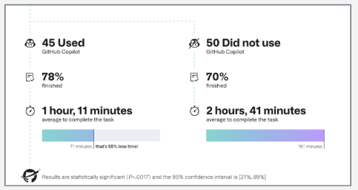
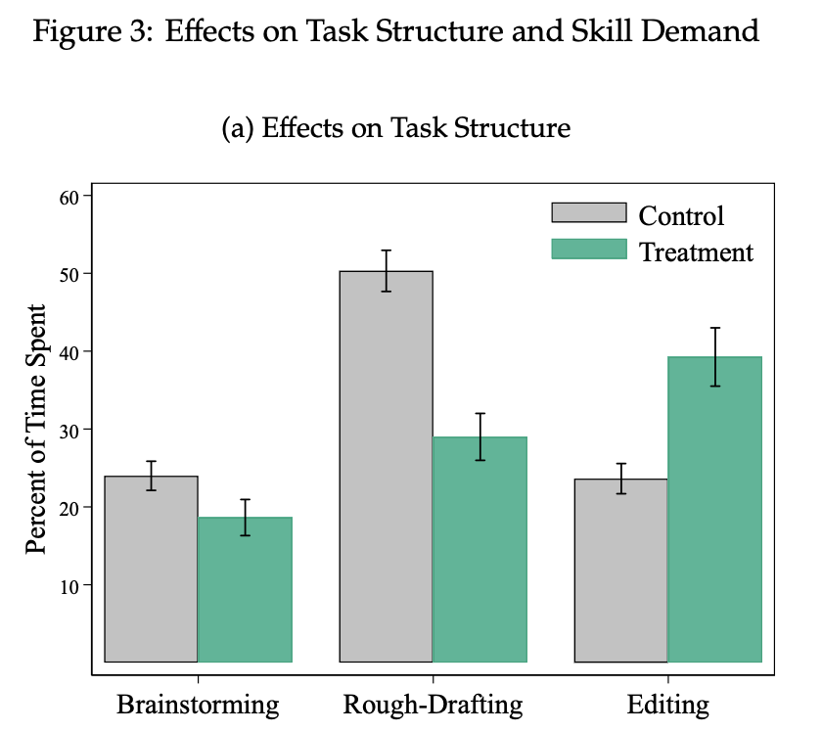
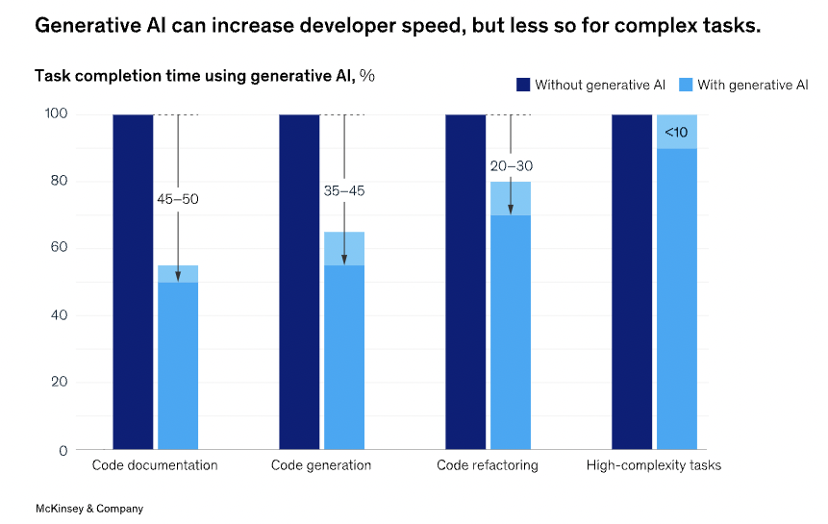
Research confirms that Copilot Speeds-up “Dev Task Completion”
GitHub 2022 (1)
McKinsey (2)
MIT (3)
95 Devs, Same Task
45 Used Copilot
55% Faster
10% more likely to complete
45-50% Faster for Code Docs
35-45% Faster for Code Gen
20-30% Faster for Refactoring
<10% for Complex Coding Tasks
Changes the Structure of Tasks:
Brainstorming 25% Writing Rough Draft 50% -> 25%
Editing 25%-> 50%
Reduces inequality
Notes:
Real Customer “Time Saved” Measurements:
Fco: 4-5 hrs/week
Aco: 4.5-10 hrs/week
Eco: 6 hrs/week
Mco: 4-5.7 hrs/week Faico: 5-10 hrs/week PSco: 5-10 hrs/week Fxco: 5.7 hrs/week
Cvco: 10 hrs/week ChCco: 5 hrs/week
MBco: 2.5 hrs/week
12 hrs is 30% of 40hrs
6 hrs is 50% timesavings

Slide 6
How Value Gets Created:
Before
After
Delay
Productive Time
VSM (Efficiency)
Delay
Productive Time
Cost
Cost
Cost
Risk
Risk
Risk
Week in the Life (Productive Capacity)
Frequency Of Change
Structural (Org Capacity)
Frequency Of Change
Parallelization of Change
Parallelization or Impact of Change

Slide 7



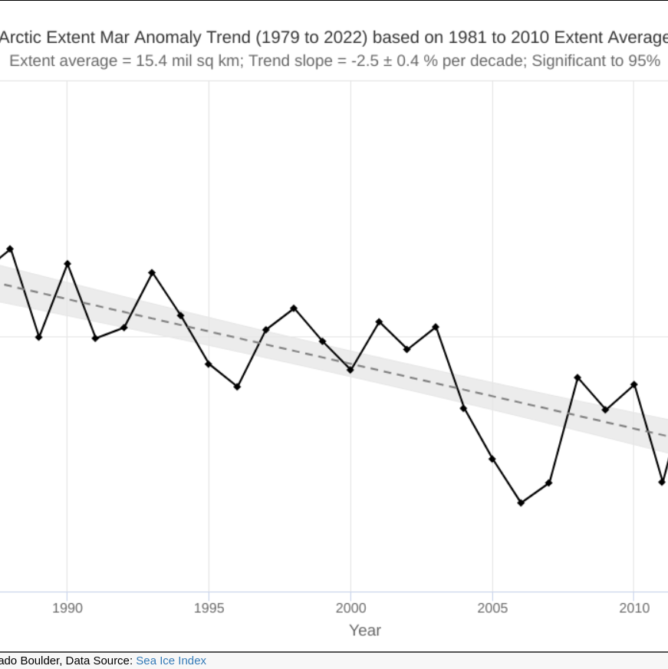
Use Modeling to set expectations for the downstream impact
?
=
=
=
Impacts further Downstream are worth pursuing, but harder to model!
25%
$9,000,000
10%
Time Savings
Economic Value*
Velocity-Boost*
Increased Tests
Increased Test Coverage Increased Remediation
Defect Reduction
*The Copilot Value Calculator can help model these outcomes.
Notes:
1000 developers that save 25% of the time that was previously spent on a coding task can expect 9 million in economic benefit and, if all the time savings goes into speed. Alternatively, time can be spent elsewhere, such as on “Defect Reduction”. Such downstream impacts are harder to model and have their own cascade of required impacts. This introduces uncertainty that may not be helpful if you are trying to evaluate copilot or debug adoption. Focus on Time savings, First.

Slide 8
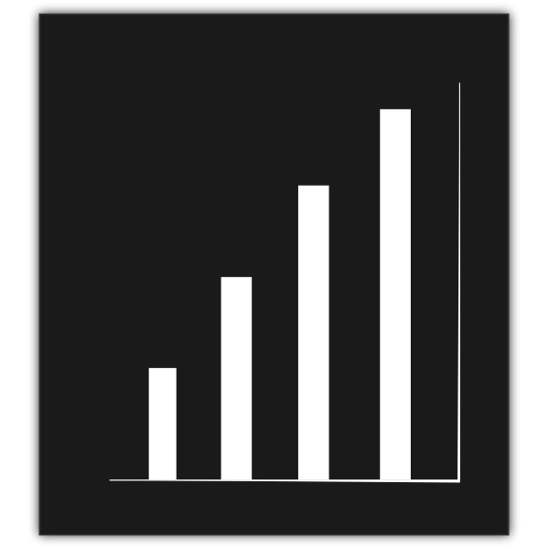
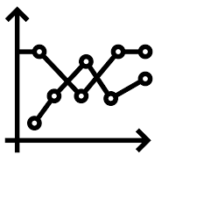


Measure adoption as a “Cascade”
Adoption
Users who have started to make efforts to use the AI tool.
Activity
For Adopters, Frequency of usage and volume of AI interactions must be above a certain level.
Efficiency Gain
Self-Report of Time Saved along with expected downstream impact.
Downstream Impact
Use the Time-Saved metric plus Expectation info to correlate AI with actual downstream impact.
Notes:
All else being equal, time savings is an efficiency gain. Could all things NOT be equal? Yes, and we touch on some of them, but sophisticated or longer term impacts of the tool is outside of the scope of this presentation.

Slide 9
Three Lenses of Improvement
Structural Lenses (Tools & Technology)
Reduce Constraints & Limitations 🚀
Copilot
Collective Lens (Teams & Processes)
Improve Coordination 🫱🏼‍🫲🏻
Make Tasks more Efficient 😅
Individual Lens (Talent)
Notes:
To quantify improvment, we need a model. One way to start is to look at individual, collective, and structural types of improvement independently to see where impacts are most significant.
AI tools are so far not affecting structure or collaboration directly
AI tools are benefitting individuals doing tasks, so we should start our modeling here.

Slide 10
First, Tasks become more Efficient
Structural Lenses (Tools & Technology)
2nd
Reduce Constraints & Limitations 🚀
1st
2nd
Collective Lens (Teams & Processes)
Improve Coordination 🫱🏼‍🫲🏻
Make Tasks more Efficient 😅
Individual Lens (Talent)
Notes:
Starting with understanding and quantifying the efficiencies created for individuals, (time savings while codeing in the case of copilot.)
It is possible to connect initial impact to larger changes that are needed for AI to be valuable at the Org Level. For example, first…. Each of these areas could be modeled, using Value Stream Mapping for example, to get more insight into how improvements will be able to link together and grow.

Slide 11
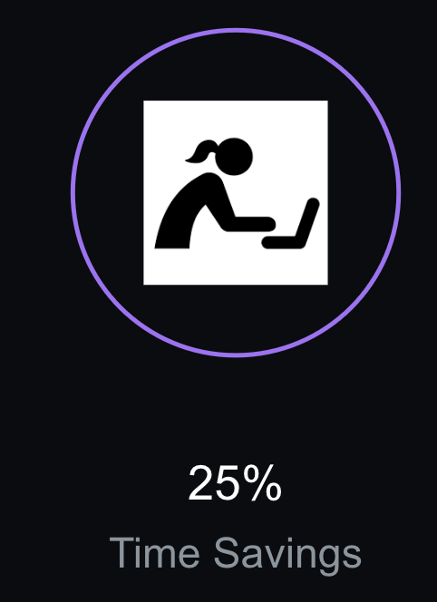
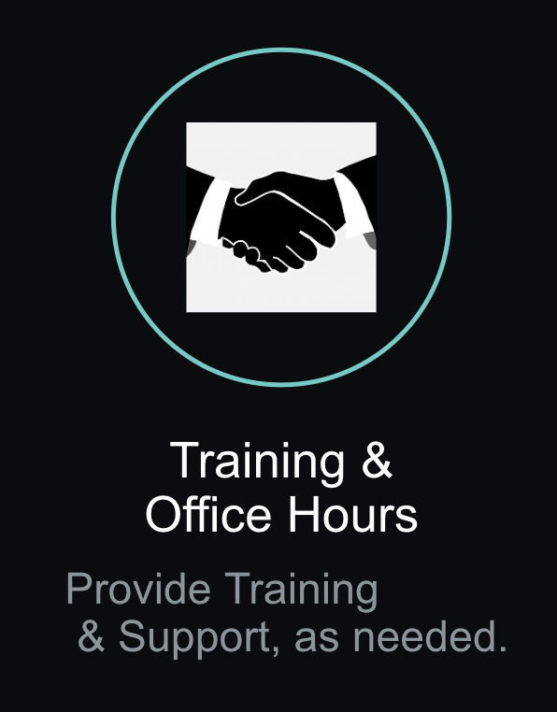
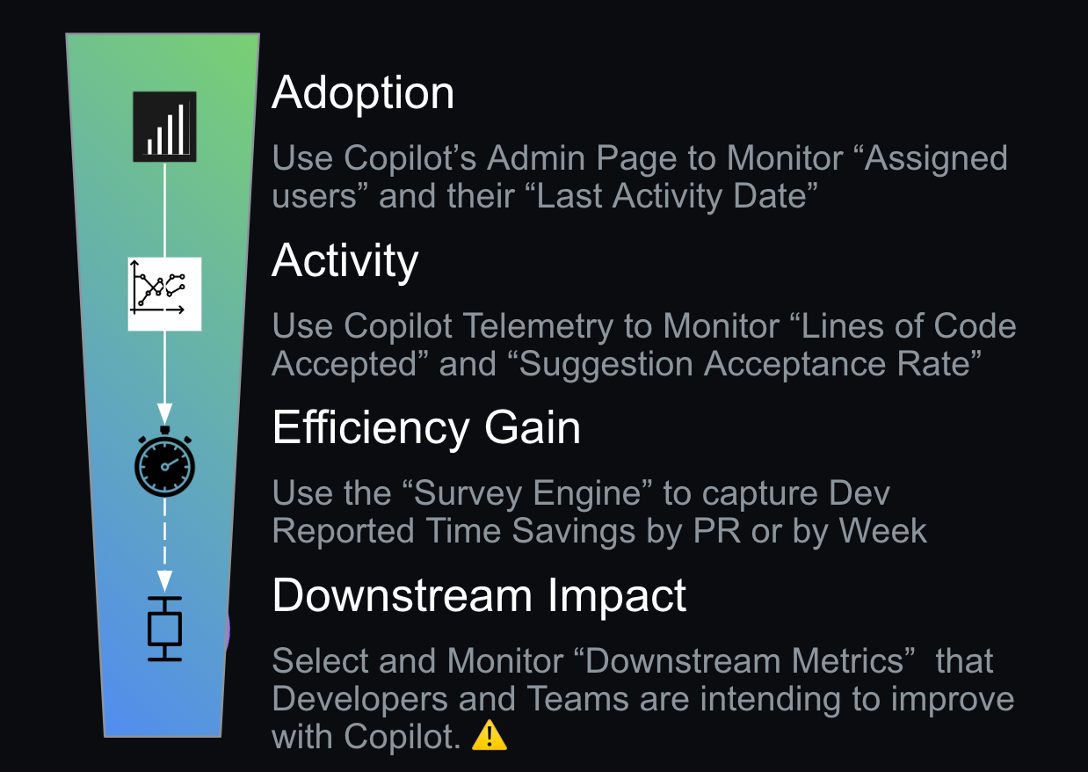
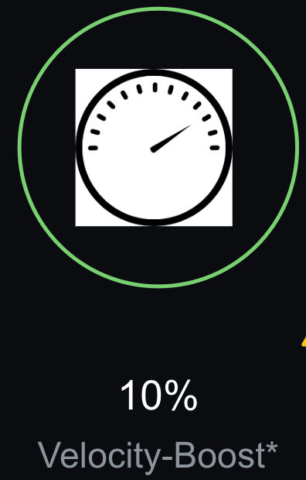
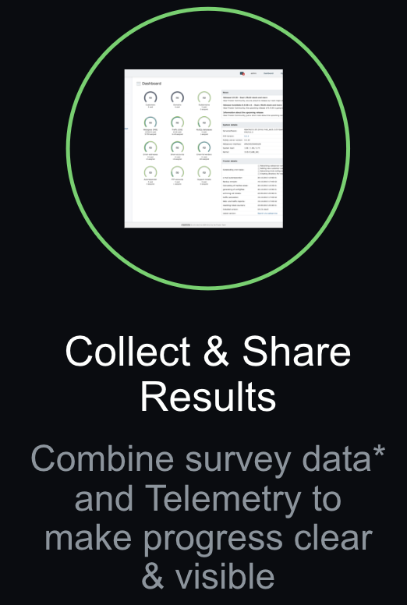
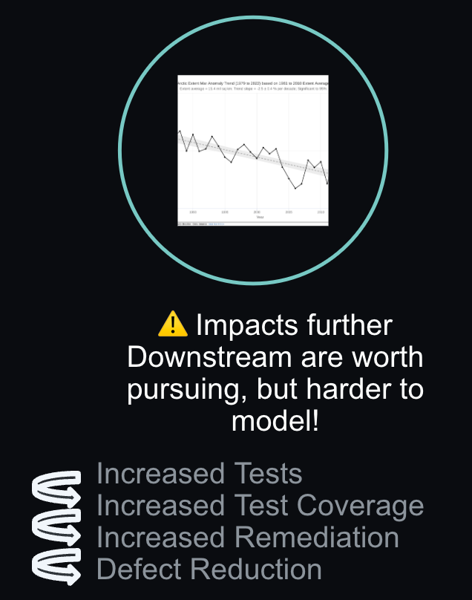
Metrics to Monitor Upstream & Downstream Impacts
Conceptual Plan for the Org-wide Rollout of Copilot
Monitor Team by Team Adoption through to Business Impact using Feedback & Metrics to Maximize Benefits, Minimize Problems
Example Metrics to Monitor a Downstream Impact:
Notes:
If we combine the adoption advice with managing and debugging the cascade, it looks like this. The cascade is central because it aligns the org on viewing & understanding the purpose and the progress.

Slide 12
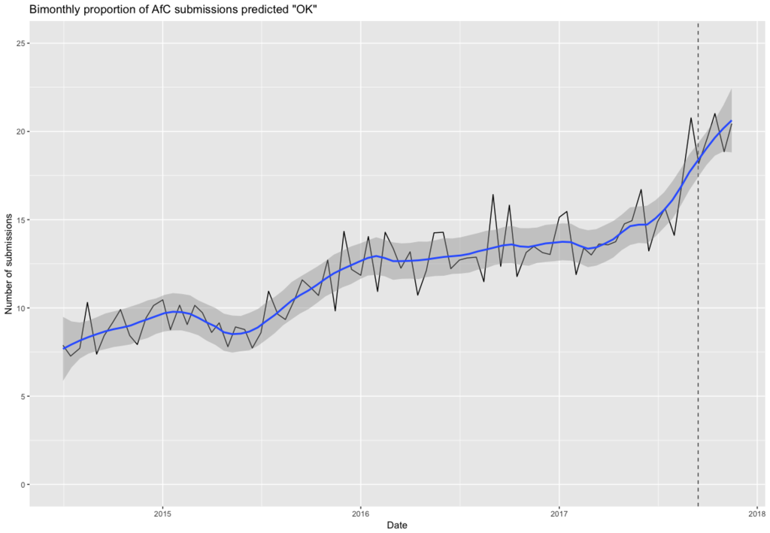

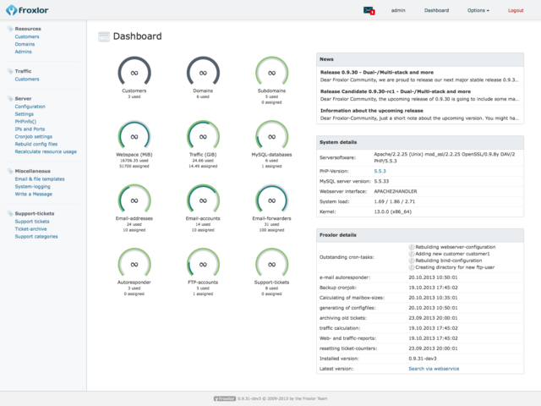

Guide the “Cascade of Benefits” so that Adoption, Usage, and Efficiency Gain scales smoothly
Pilot Team
Selection
Collect & Share Results
Training & Office Hours
Rollout Planning
Team Adoption with consistent, predictable performance make benefits clearer.
Well planned rollout minimizes confusion, misalignment, and
false starts.
Combine survey data* and Telemetry to make progress clear & visible
Provide Training & Support, as needed.
*The Copilot Survey Engine can help survey developer reported time-savings.
Notes:
Start by giving Copilot to a cohort of well-respected developers working in a stable, high-performing team. This has two benefits:
(a) Your evaluation is more likely to produce "clean" results, untarnished by the distractions of a team navigating organizational or acute technical challenges.
(b) Feedback delivered from a well-respected team is more likely to have credibility – when both (i) making a purchasing decision, and (ii) scaling to the rest of your org.
Put structure in place to prove-out that the cascade of impacts is possible and is creating benefits that justify the costs. Transparency and helping individuals navigate the learning curve is recommended so that knowledge gaps are minimized leading to better results.
When you decide to scale adoption (a) Hold an event where engineering leaders (S/VPs) invite the trial participants to share their success stories. Leaders should praise these stories, and give a full-throated endorsement of their practices. (b) The Leader's goal should be to create a social incentive where SWEs want to emulate the behaviour of their peers by adopting new-and-exciting tools.
Create dashboards (a) measuring Copilot engagement for each Director-level manager. This shouldn't be used as an enforcement tool, but rather as a way of measuring adoption in the org. Make sure Directors know leaders are looking at the dashboard. (b) If adoption isn't happening within a Director's team, why? Is there a shortcoming of the tool? If so, the product team wants your feedback.
When SWEs first adopt Copilot (a) Make sure they get training. It doesn't need to be a weeklong course. It can be a 1 or 2 hour workshop. GitHub's Expert Services have a good workshop you can use. We've found that acceptance rate tends to improve about 1% per month for the first six months using Copilot. (b) With a little training, you can compress that learning into a fraction of the time.
- Here you have a choice. You can onboard developers team-by-team, or you can allow developers to onboard at their own pace. If you go team-by-team, then you can host group training sessions. If you allow developers to opt-in, then you'll need to find another way to ensure they get training at the appropriate time
- For user management, there's an API.

Slide 13
Time Savings is surprisingly consistent, but still Varies
Pharma: 4 -10 hrs/week saved
Information Svcs: 6 hrs/week saved
Financial Software: 4 - 5 hrs/week saved
Mfg Company: 2.5 - 5.7 hrs/week saved
Notes:
Different organizations are finding different levels of results. This isn’t too surprising and reflects similar diversity in research findings. SEE research in-Depth below.
Fco: 4-5 hrs/week
Aco: 4.5-10 hrs/week
MBco: 2.5 hrs/week
Eco: 6 hrs/week
Mco: 4-5.7 hrs/week

Slide 14
While Evaluating Watch out for…
Survey fatigue - Use surveys sparingly, but do enough to see trends
Biased self-reporting - Validate reasoning
Poor Momentum - Train, involve, & debug team adoption
Unrealistic expectations - Model impacts cautiously. Calibrate expectations.
Notes:
Some of the concerns to be aware of include these. In general, these are no different than typical Risks of LEARNING and Adopting a new tech.

Slide 15
During Roll-out Watch out for…
Changes in Rate of Defects, Rate of Test creation
Velocity-gains driving up WIP & Queue depths
Speed exacerbating areas of Poor Coordination (Security Reviews?)
Unrealistic expectations, knowledge gaps
Notes:
Velocity is a weak signal for Copilot adoption relative to Efficiency Gain (or Time savings) during Dev Tasks. If you are pursuing Velocity, these undesirable side-effects are worth keeping an eye out for.

Slide 16
Topics In-Depth
Research & Examples of Benefits
Modeling & Value Quantification
Understanding the Impact of Copilot
🩻 Research on the Impact of Copilot
2022 GitHub Research
McKinsey Research
MIT Research on ChatGPT impact on Professional Writing
2023 GitHub Research
Duolingo Customer Story
Coyote Logistics Customer Story
Understanding Business Value Engineering
🔭 What is Business Value Engineering?
🔍 Modeling Copilot: Improving Dev Task Completion
🧮 Impact Calculator: Benefits at Scale
📏 Measuring Copilot Efficiency Gain (Survey Techniques)
🎯 Targeting Downstream Improvement
🕵️‍♀️ Measurement and Evaluation Experiences
🔬 Additional Survey Engine Details
🔗 2-step Quantification & Validation Survey Technique
Notes:
The remaining slides are listed here and should be fairly self explanatory. Each slide is intended to be read rather than presented, but are included for completeness and convenience.

Slide 17
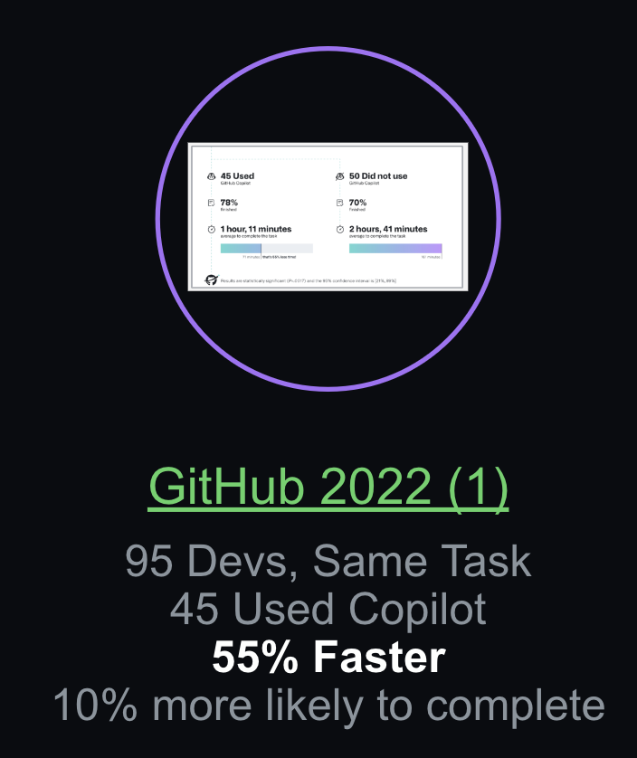
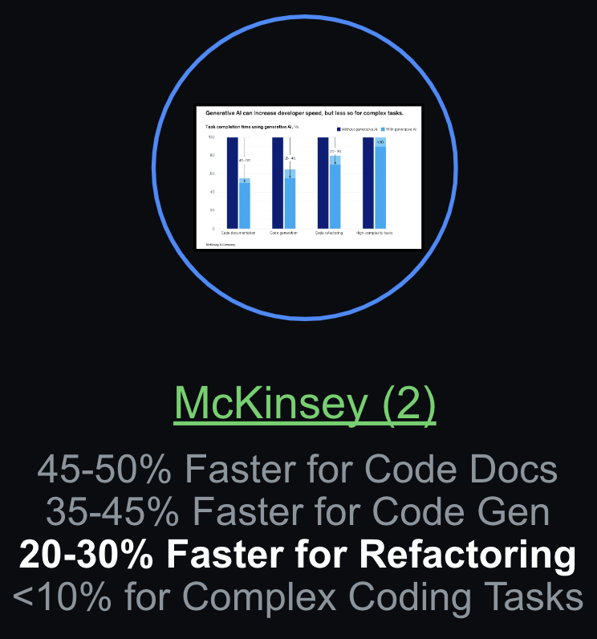
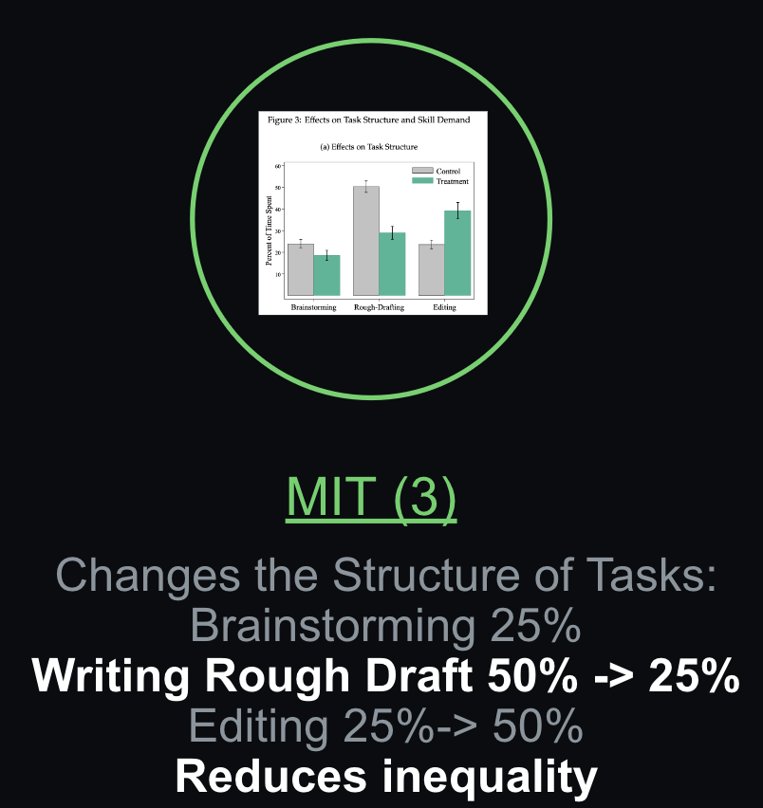
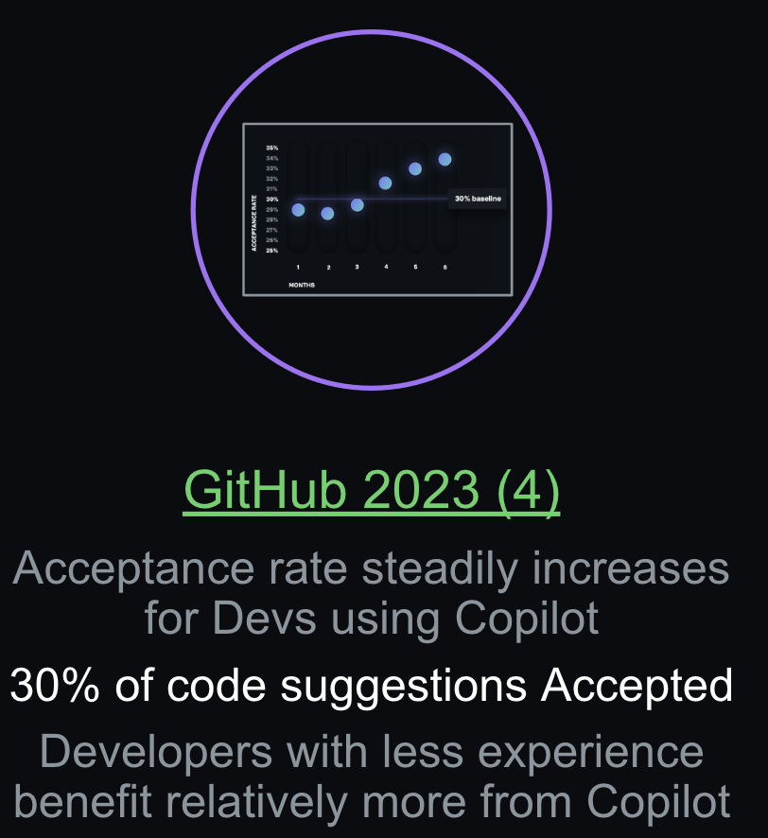
🩻 Research on the Impact of Copilot
Improving Development Task Completion is the focus of the research, modeling, and calculations provided below.
Multiple studies (from GitHub research from 2022 (1), McKinsey research from June 2023 (2) , research done by MIT in March 2023 (3), & more recent GitHub research (4), have investigated Copilot’s ability to speed up Dev Task Completion have found:
Copilot delivers 10-55% efficiency gains for development tasks.
Copilot reduces task duration, cost, and risk.
At the aggregate level, tools like Copilot substantially compress the productivity distribution across a diverse set of developers, reducing inequality.

Slide 18
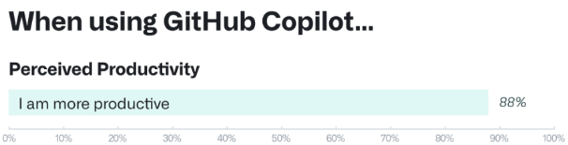
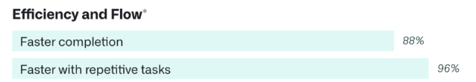
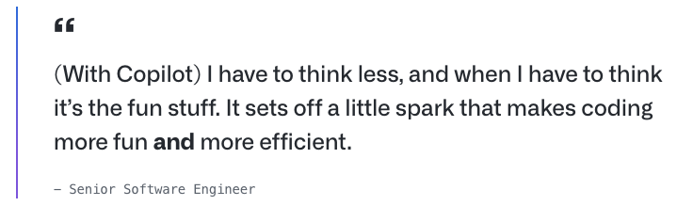
GitHub Copilot Research (Sept, 2022 )
Through a large-scale survey, we wanted to see if developers using GitHub Copilot see benefits in other areas beyond speeding up tasks. Here’s what stood out:
Improving developer satisfaction. Between 60–75% of users reported they feel more fulfilled with their job, feel less frustrated when coding, and are able to focus on more satisfying work when using GitHub Copilot. That’s a win for developers feeling good about what they do!
Conserving mental energy. Developers reported that GitHub Copilot helped them stay in the flow (73%) and preserve mental effort during repetitive tasks (87%). That’s developer happiness right there, since we know from previous research that context switches and interruptions can ruin a developer’s day, and that certain types of work are draining [8, 9].
In the experiment, we measured—on average—how successful each group was in completing the task and how long each group took to finish.
The group that used GitHub Copilot had a higher rate of completing the task (78%, compared to 70% in the group without Copilot).
The striking difference was that developers who used GitHub Copilot completed the task significantly faster–55% faster than the developers who didn’t use GitHub Copilot. Specifically, the developers using GitHub Copilot took on average 1 hour and 11 minutes to complete the task, while the developers who didn’t use GitHub Copilot took on average 2 hours and 41 minutes. These results are statistically significant (P=.0017) and the 95% confidence interval for the percentage speed gain is [21%, 89%].

Slide 19
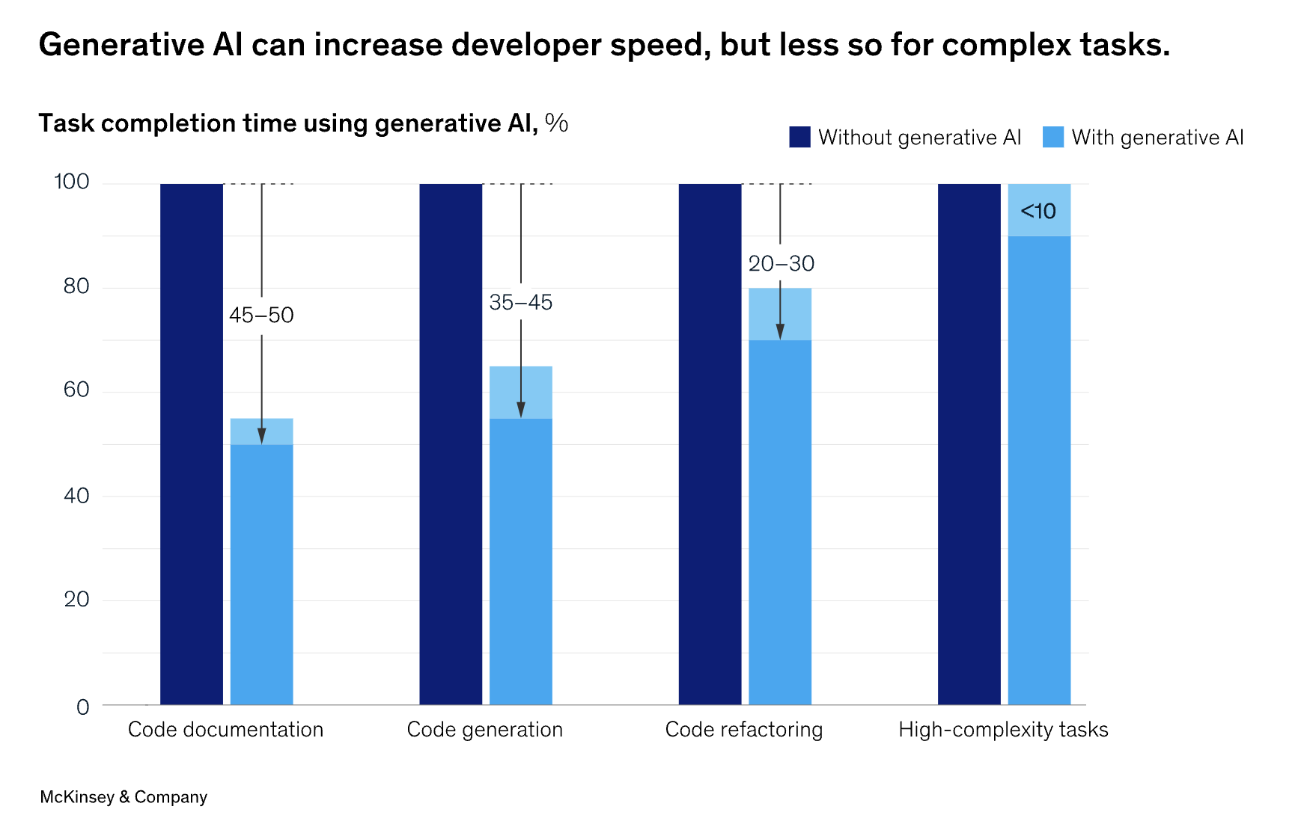
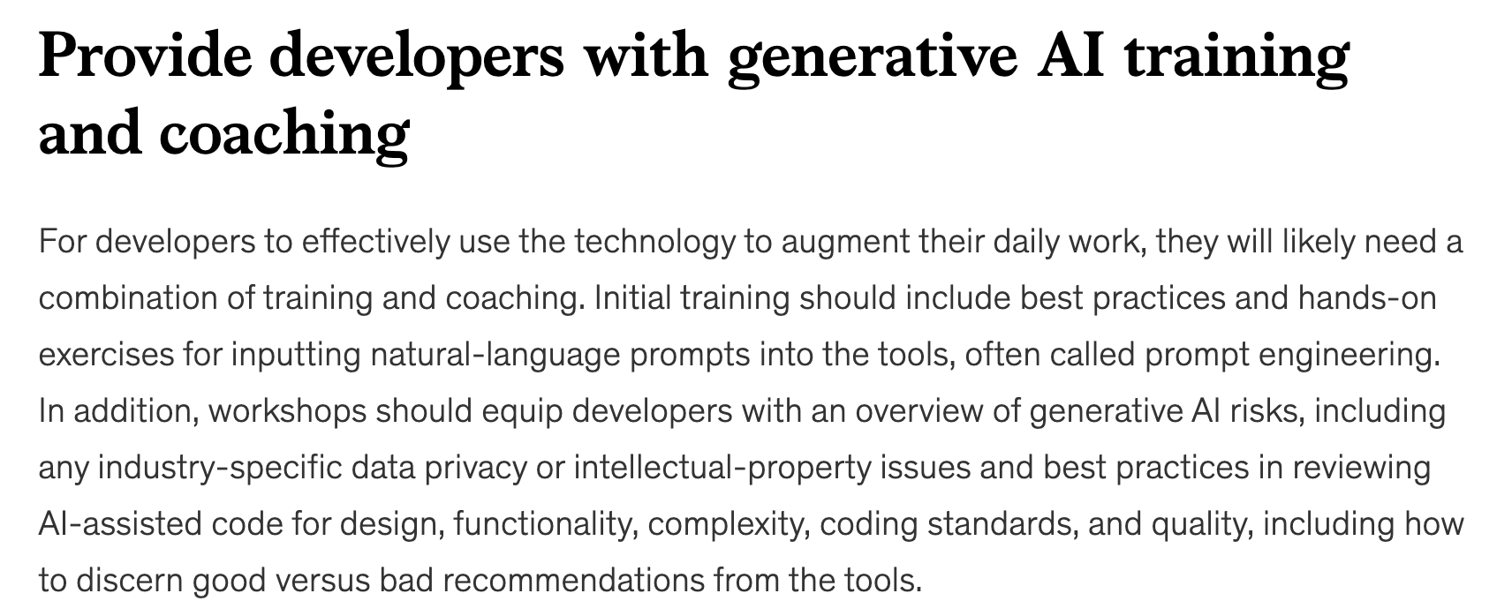
(2) McKinsey Research (June, 2023 )
In our study, we assigned developers some garden-variety tasks that software teams do regularly: refactor a piece of code into microservices to improve maintainability and reusability, build new application functionality to elevate the customer experience, and document code capabilities so future changes are easier.
Across these tasks, our research finds generative AI–based tools enable tremendous productivity gains in four key areas:
Expediting manual and repetitive work.
Jump-starting the first draft of new code.
Accelerating updates to existing code. Participants also reported that when using these tools with effective prompting, they could make more changes to existing code faster.
Increasing developers’ ability to tackle new challenges. While developer time savings with generative AI–based tools were more modest for complex tasks, our research still finds benefits: the technology can help developers rapidly brush up on an unfamiliar code base, language, or framework necessary to get the job done. Furthermore, when developers face a new challenge, they can turn to these tools to provide the kind of help they might otherwise seek from an experienced colleague—for example, explaining new concepts, synthesizing information (say, by comparing and contrasting code from different repositories), and providing step-by-step guides on how to use a framework so they can do the work.
Thus, developers using generative AI–based tools to perform complex tasks were 25 to 30 percent more likely than those without the tools to complete those tasks within the time frame given.

Slide 20
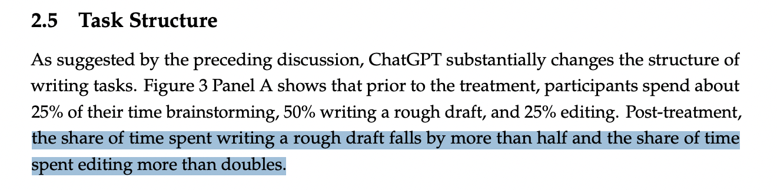
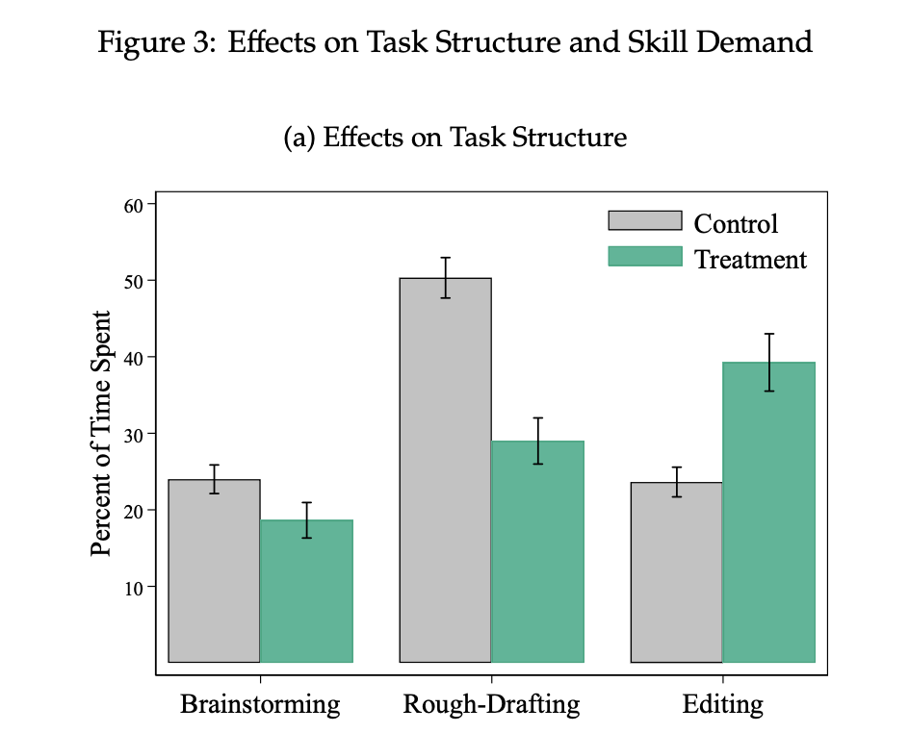
(3) MIT Research (March, 2023 )
From research done by MIT in March 2023, which was focused on the use of Generative AI (ChatGPT) to complete mid-level professional writing tasks, it was found that users actually changed the structure of how they completed the task. This restructuring of work is further described in the graphical excerpt.
The MIT paper summarizes the impact of generative AI usage with the following statement:
“The generative writing tool increases the output quality of low-ability workers while reducing their time spent, and it allows high-ability workers to maintain their quality standards while becoming significantly faster. At the aggregate level, ChatGPT substantially compresses the productivity distribution, reducing inequality.”
“

Slide 21
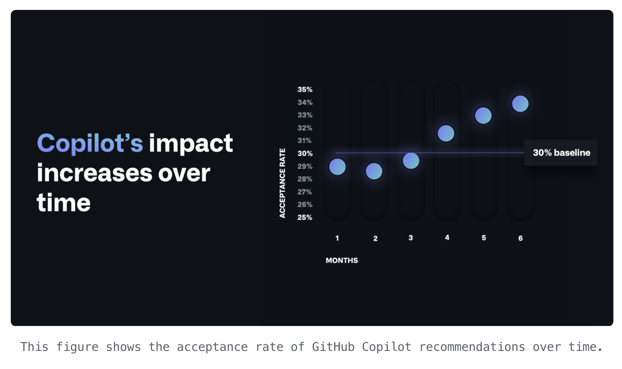
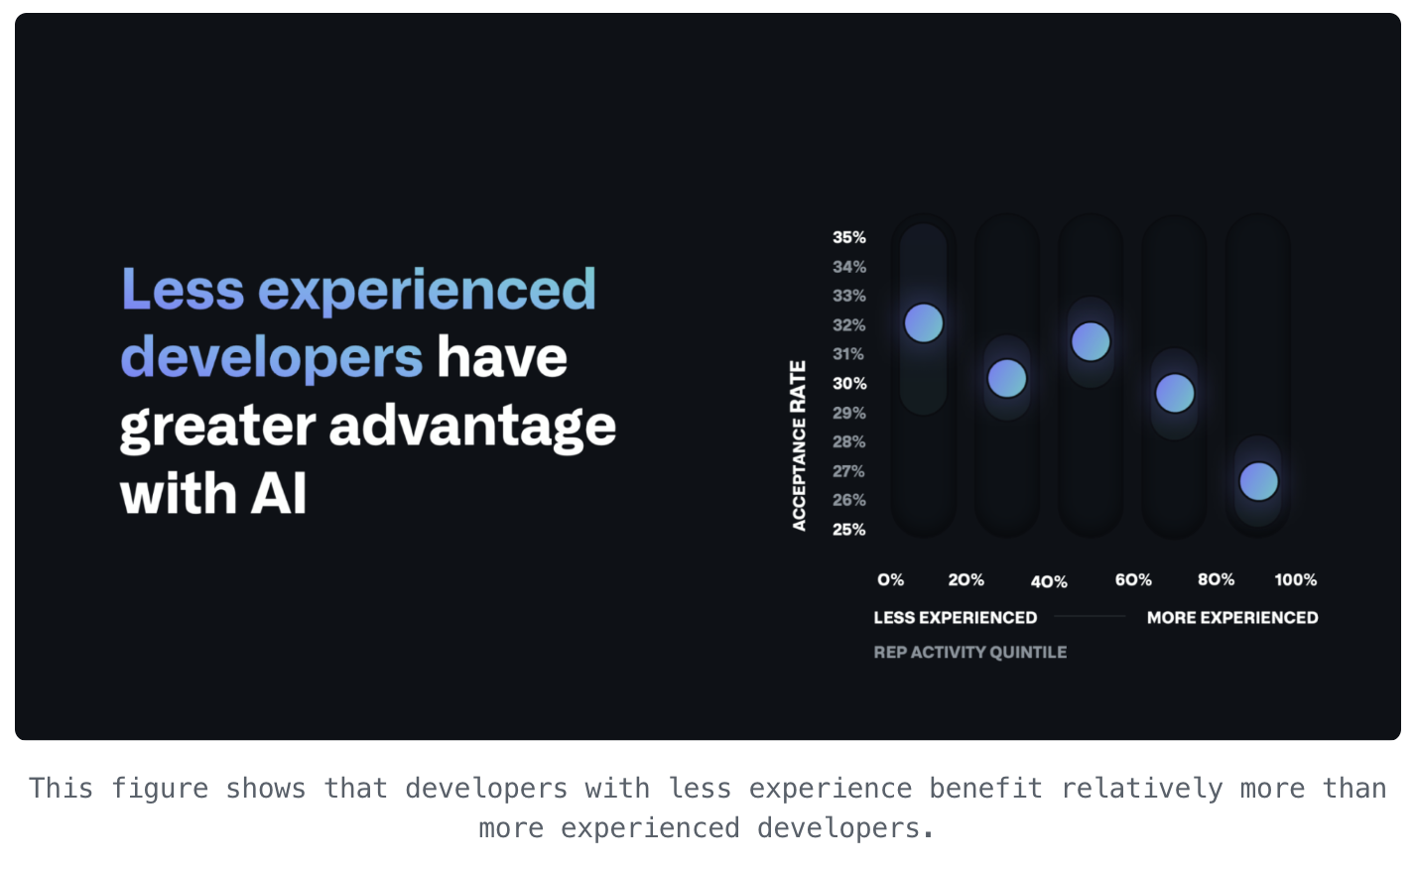
(4) GitHub Copilot Research (June, 2023 )
Based on recent research, GitHub Copilot is turbocharging developer productivity. Analysis on a large sample of GitHub Copilot users (n = 934,533) reveals a sizable productivity impact. On average, within the first year in the market, users accept nearly 30% of code suggestions from GitHub Copilot and report increased productivity from these acceptances. Furthermore, we found that over time, the acceptance rate steadily increased as developers became more familiar with the tool. This suggests that GitHub Copilot has a large runway to continue its impact on developer productivity, as users become more accustomed to developing software with it.
Less experienced developers benefit more from GitHub Copilot. Our study also found that less experienced developers have a greater advantage with tools like GitHub Copilot, which is corroborated by other studies, including our own previous experiments on the impact of AI on developer productivity. As developers use these tools to upskill, they will become more fluent in prompting and interacting with AI to power the development lifecycle. This will ultimately help democratize software development for more people, help close the labor gap, and establish AI pair programming tools as part of the standard developer education experience.

Slide 22
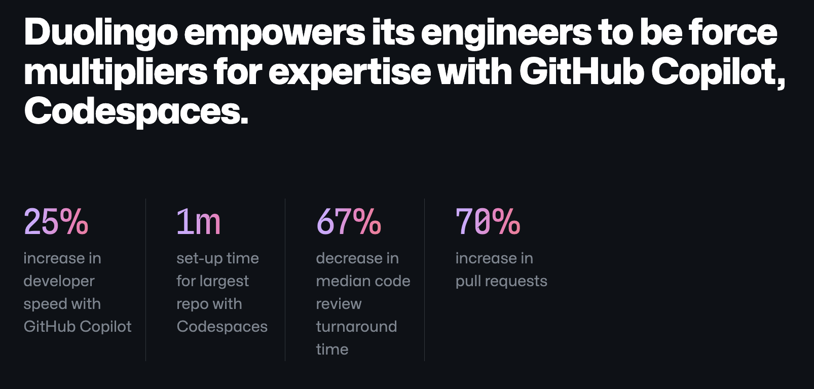

Slide 23





Coyote Logistics is on the move with…
GitHub-powered solutions
GitHub Copilot—Increased developer efficiency by limiting context switching
50% less time to write Terraform config files
GitHub Codespaces—Avoids time spent manually setting up local dev environments
1 hour of time saved per developer per day
GitHub Enterprise— Centralized 80% of source code on GitHub
GitHub Advanced Security—Reduces manual code review by security team.
50% reduction in manual code review
GitHub Actions—Pre-approved Actions enable devs to deploy their own automations
1 hour per day per developer time savings
Impact
With GitHub’s innovative tooling, developers recapture ~2 work-months per year!
Notes:
Coyote Logistics, a UPS company, is a leading global third-party logistics provider, matching shippers and carriers with supply chain solutions including over 10,000 shipments daily. Read the full customer story here.
Industry
Shipping & Logistics
Themes
AI
GitHub Products
GitHub Enterprise— Coyote Logistics migrated to GitHub Enterprise to take advantage of the cutting-edge tools coming out of GitHub’s platform, like Copilot. Now about 80% of the company's code has been migrated to GitHub from Azure DevOps.
Dependabot makes it trivial to resolve known security issues in dependencies by automatically generating pull requests with fixes. Prevents build issues or other problems that arise when developers might be using different versions of the same dependency.
GitHub Actions—Developers can build their own automations to solve their individual needs, or choose from several pre-approved actions with compliance policies baked in, instead of engaging in a lengthy back-and-forth process with the delivery engineering team, freeing them up to focus on mission-critical CI/CD pipelines used across multiple teams.
1 hour per day per developer time saved thanks to self-serve creation of automations with GitHub Actions
GitHub Advanced Security—Uses GitHub Advanced Security to reduce the amount of manual code review they must do. For codebases not hosted on GitHub, every single pull request has to be manually reviewed, which can mean dozens of code reviews per day. But, for repositories on GitHub, his team can use Advanced Security to flag pull requests with potential issues, while automatically approving low-risk changes.
50% reduction in manual code reviews for the cloud delivery team with GitHub Advanced Security
GitHub Copilot— Saves Coyote’s developers time and effort, reducing the amount of context switching they need to do (like looking up conventions on Stack Overflow). Copilot has energized Coyote’s developers, because now they can really focus on innovating, rather than sinking time into less rewarding tasks like writing and debugging regular expressions.
50% less time to write Terraform config files when using GitHub Copilot
GitHub Codespaces— Employees across the company are also using Codespaces to avoid manually setting up local development environments, which is particularly useful for quality assurance teams that previously spent a fair amount of time setting up an environment just to run a single 15-minute test. Codespaces also cuts down on time lost from context switching, as developers can move from one development environment to another with ease.
1 hour of time saved per developer per day by using GitHub Codespaces instead of configuring a local development environment
Key Quotes
“Developer experience is often forgotten, so having tools like GitHub Copilot for developers has made us more excited to come to work and innovate. It's brought new life and energy to our teams." Chris Taylor / Enterprise Architect
“It used to take me twenty or thirty minutes to write a Terraform configuration. Now with GitHub Copilot, it saves me ten minutes.” Gavin Borgeson / Cloud Delivery Engineer
“With GitHub Copilot, now we can code as fast as we can think. Instead of having to open a browser, search for something in Stack Overflow or Confluence, and then go back to your code editor and figure out how to incorporate what you learned, you can just generate what you need with GitHub Copilot. The time it saves by keeping us focused is immeasurable.” Chris Taylor / Enterprise Architect
"All the time we'd have to spend going back and forth with a developer setting up a new custom workflow is compressed significantly with GitHub Actions." Chris Taylor / Enterprise Architect
“Dependabot gives visibility into security issues with our code and helps our managers understand when they need to step in.” Scott Atkinson / Software Architect
"With Codespaces, we don't have to walk all of our developers through configuring a local environment for a particular application," Atkinson says. "Once it’s running, you can share it and anyone in the company can use it. It's perfectly reproducible." Scott Atkinson / Software Architect
Codespaces makes training much easier. I don't have to make sure each person downloads a local container management solution and unzips all the right files to the right locations. They just spin up a Codespace, fire up some containers, and we can get started right away." Justin Ivins / Enterprise Architect

Slide 24
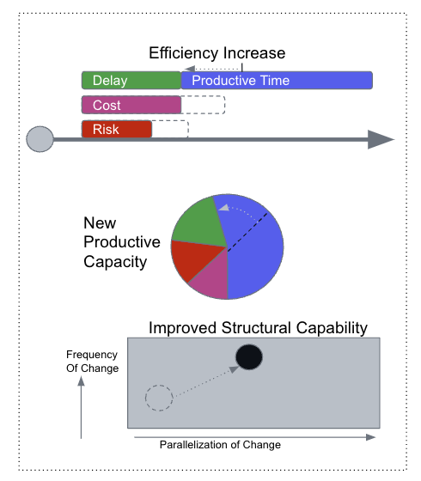
🔭 What is Business Value Engineering?
Business Value Engineering (BVE) provides a framework for guiding and validating improvement efforts across an organization. Data from various sources are combined to clarify the impacts of improvements. These can be any of the following types of improvements:
Types of Change:
Process changes (e.g. reduce steps, add automation)
Product Features (e.g. reduce effort, share control, or visibility)
New Practices (e.g. adopt new standards or rituals, improve decision-making)
Comparing Before and After To calculate the improvement potential, a before vs after comparison is created with one or more proposed changes. For each change, the expected impact on Cost 💵, Delay ⏱, or Risk 🦺 is modeled for a time-period, step, or unit of work. Using findings from these small comparisons, the aggregate impact can be analyzed and communicated via one of several value-viewpoints.
Value-Viewpoints
Efficiency Viewpoint: Evaluate the improvement for the Processes (via value stream mapping) for each “unit of work” that will be affected by the change(s).
Productive Capacity Viewpoint: Evaluate the improvement for individual participants (via “Week in the Life” surveys) for those that will be affected by the change(s).
Structural Viewpoint: Understand and clarify how the improvements structurally improve what the organization can do in terms of increasing the options for being responsive or by for coordinating parallel efforts. This can be thought of as “structural leverage” (e.g. Rate of change, Ability to adapt and grow, Expand Collaboration)

Slide 25
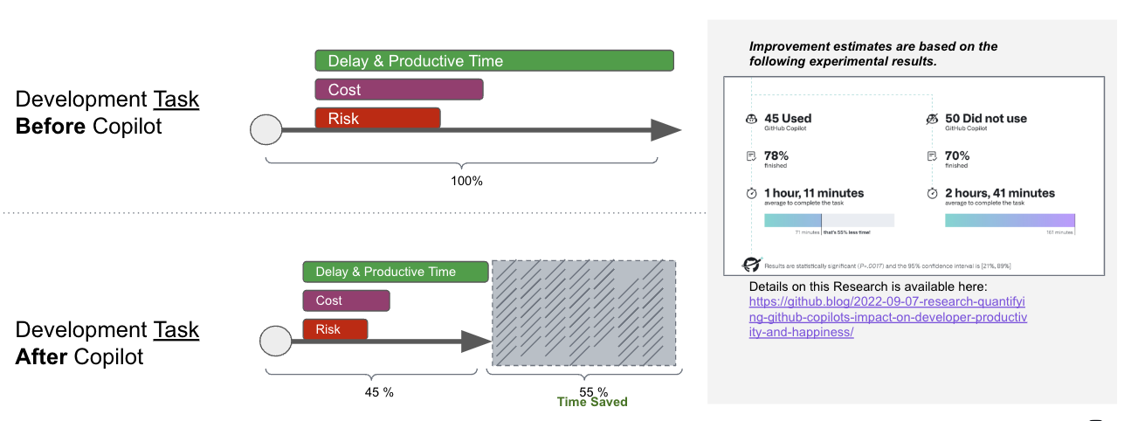
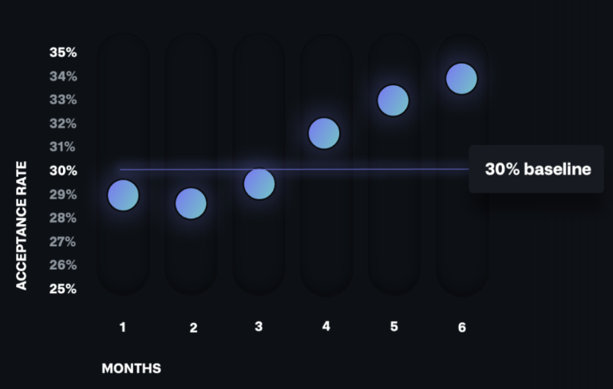
1
🔍 Modeling Copilot: Improving Development Task Completion The four research examples listed above provide strong evidence that GitHub Copilot is able to promote faster dev task completion. More critically, combined with Business value engineering, the resulting model provides insight into how these benefits accrue to the Developer, Team, and Organizational levels.
Cost, Delay, Risk reductions on Task Completion
The Task view on the right shows that faster task completion can be viewed using a Value Stream Mapping Perspective(VSM). The VSM view highlights the improvements (55% shorter Delay) resulting from Copilot usage, simultaneously reducing task cost, and the risk of failure or disruption during the task.
Real World expectations supported by Research findings
Developers finish Dev Tasks 55% faster (1)
Developers finish Dev Tasks faster depending on the Type of Task (2)
Junior Developers finish Dev Tasks faster and with less Risk of Failure (3)
Senior Developers finish Dev Tasks faster at equivalent Risk of Failure.(3)
Developers accept a higher percentage of suggestions over time (4)
2
3
4

Slide 26
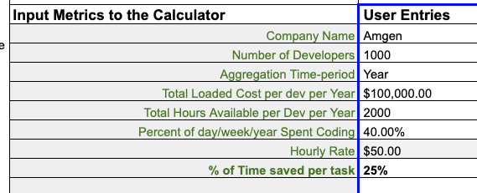
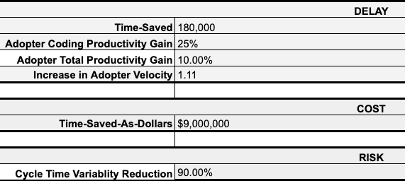
🧮 Impact Calculator: Understanding Benefits at Scale The Copilot Value Calculator converts per developer and per task inputs to quantify Cost, Delay, and Risk reduction potential for the organization or team.
Inputs can either be Assumptions or Measurements.
Key Inputs
Number of Developers ( & percent Adoption of Copilot)
Total Loaded Costs/Year
Percent of Time Spent Coding
Percent of Time Saved per Dev Task
Example Calculation ( 1000 Developer Organization, 90% adoption):
They spend 40% of 2000 hours coding per year
They complete dev tasks 25% faster. (This is the only impact being modeled at present and the speed up is limited to Time spent Coding given in step (1))
The modeled economic benefit of the efficiency gain would be: 90% X 1000 X $100,000 X 40%(time spent coding) X 25%(copilot speedup) = $9 million
The calculated velocity increase (best case) would be the ratio of [2000 hrs X 1000 devs ] / [2000 hrs X 1000 devs ] - [2000 hrs X 1000 devs X 40% X 25%] = 11%

Slide 27
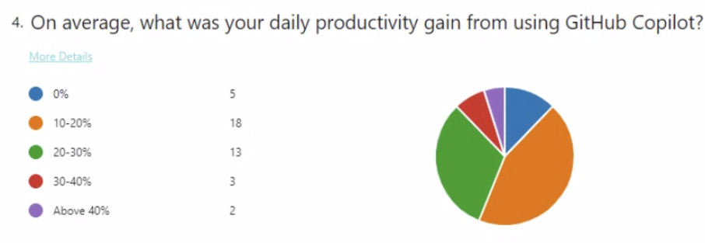
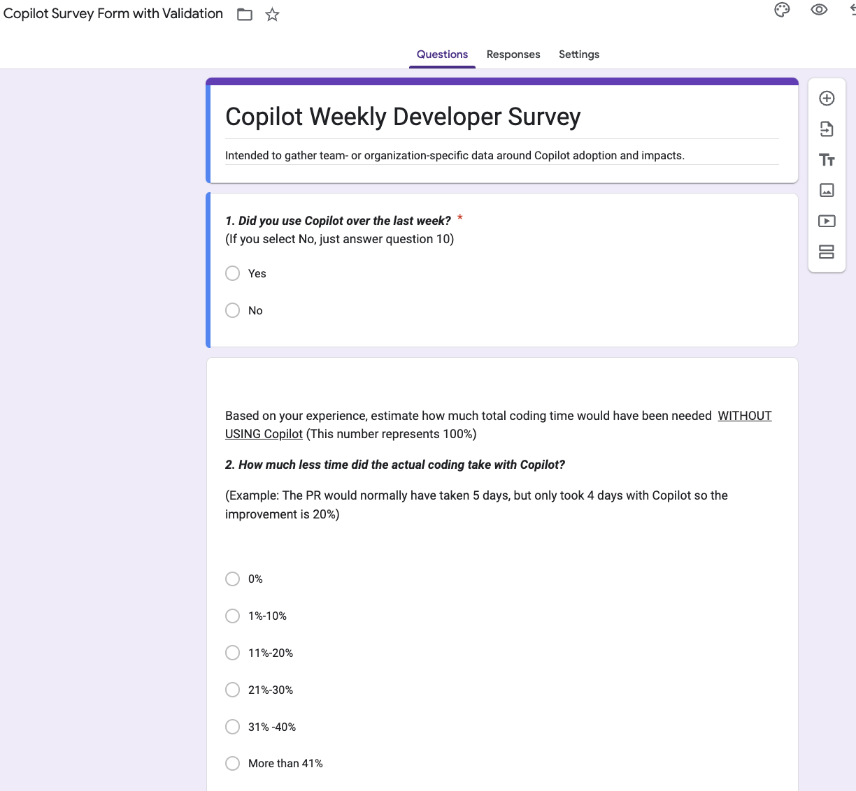
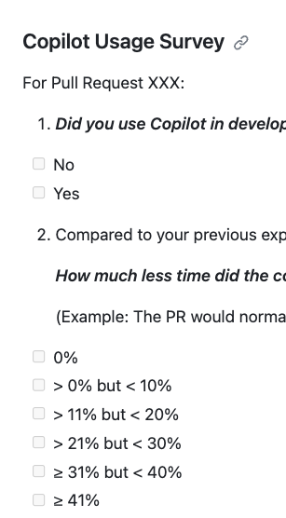
📏 Measuring Copilot Efficiency Gain The Efficiency Gain from Copilot is critical to measure because downstream impacts like increased velocity, code refactoring goals, or something like reduction in defects are all limited by the level of Efficiency Gain.
Efficiency Gain Measurement should be used as input to the Value Calculator to calculate Economic Value and Expected Maximum Velocity Gain. These calculations help set realistic expectations for improvement. Likewise, a Velocity Gain Measurement (rate of PRs, for example) can be used to find the corresponding upstream Efficiency Gain via the Calculator.
Survey Techniques to boost objectivity
Use the 2-step Quantification & Validation technique to get reliable time-savings data via Surveys
Use GitHub Automation to prompt and record feedback for each PR. See Survey Engine example repo
Prompt via Google or Office365 Form URL’s in PR Template

Slide 28
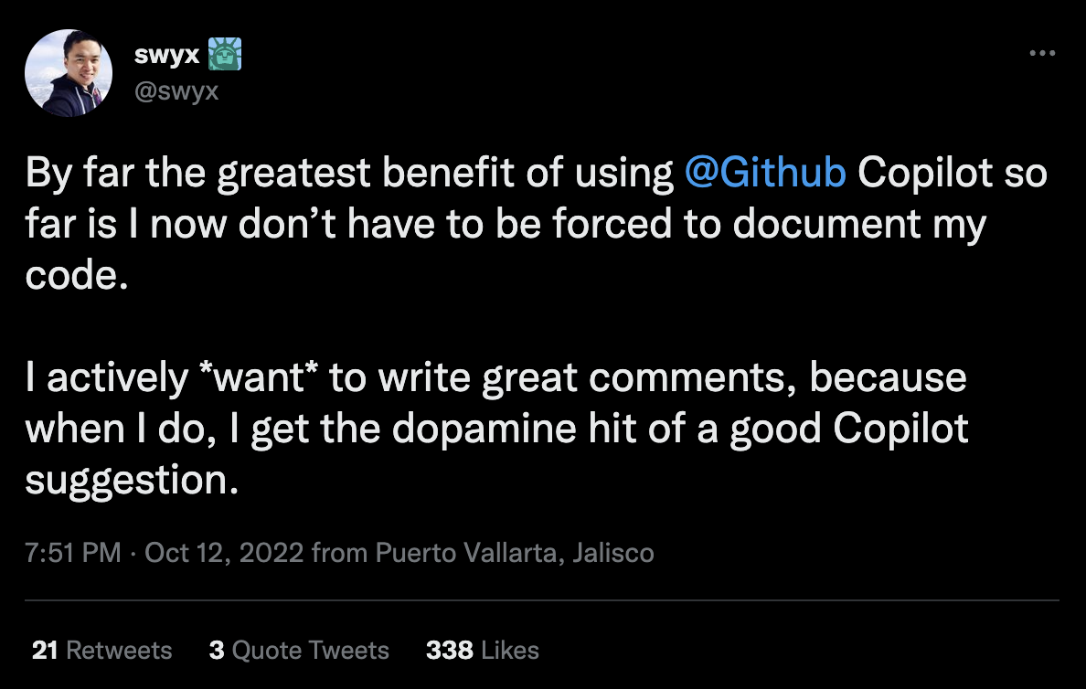
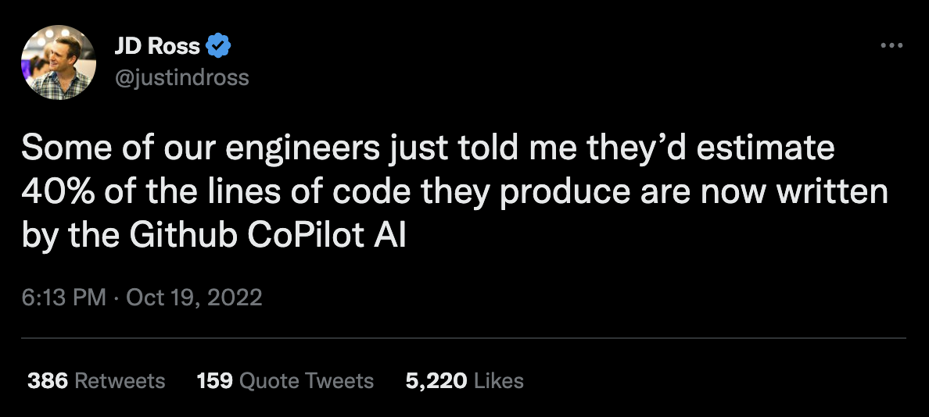
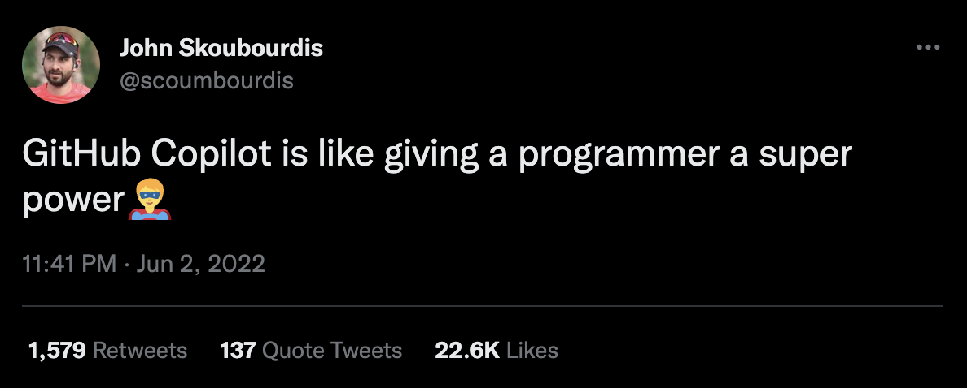
🎯 Targeting Downstream Improvement
There are a broad range of possible downstream improvements that the Time-Savings provided by Copilot can drive. Velocity, Code Modularity, Testing, Automation, Documentation, Reduction of Tech Debt, Security, Learning & Adopting new skills, etc.
Downstream improvements require that the Efficiency Gains(Time-Savings) have been achieved first at the developer level. (This should be confirmed before attempting to measure Downstream impacts.)
How developers are “spending” their Efficiency Gains is very critical to understand and coordinate. Focus on measuring improvement metrics (e.g. Velocity, Rate of PRs, Defect levels, Test coverage) that are intentionally being improved. Monitor other metrics like “Work in Process” to catch “unintended consequences”.
When focusing on a specific improvement metric, like tests, velocity, or remediations. Consider the history of that metric in the organization. Has the organization been able to improve it in the past? Value Stream Mapping can reveal structural constraints that may be preventing progress. The ‘Rate of PRs' is an initial indicator of downstream impact that some organizations are able to measure. The ‘Rate of PRs' can be a good measure for Copilot because it can reflect the developer-by-developer velocity improvements. PR rates can increase as long as stories are available in their backlog and developers have speed as a goal.
Be realistic about downstream impacts. The time savings from Copilot will only go so far and in only so many directions. For example, the modeling of the 1000 developer organization above, indicates that a theoretical maximum velocity improvement from the 55% time savings is 28%. If, on the other hand, the time-savings was only 25%, the velocity gain would be only 11%.
By monitoring Copilot’s adoption, efficiency gain, and downstream impacts, organizations can track the progress of Copilot Value over time.

Slide 29

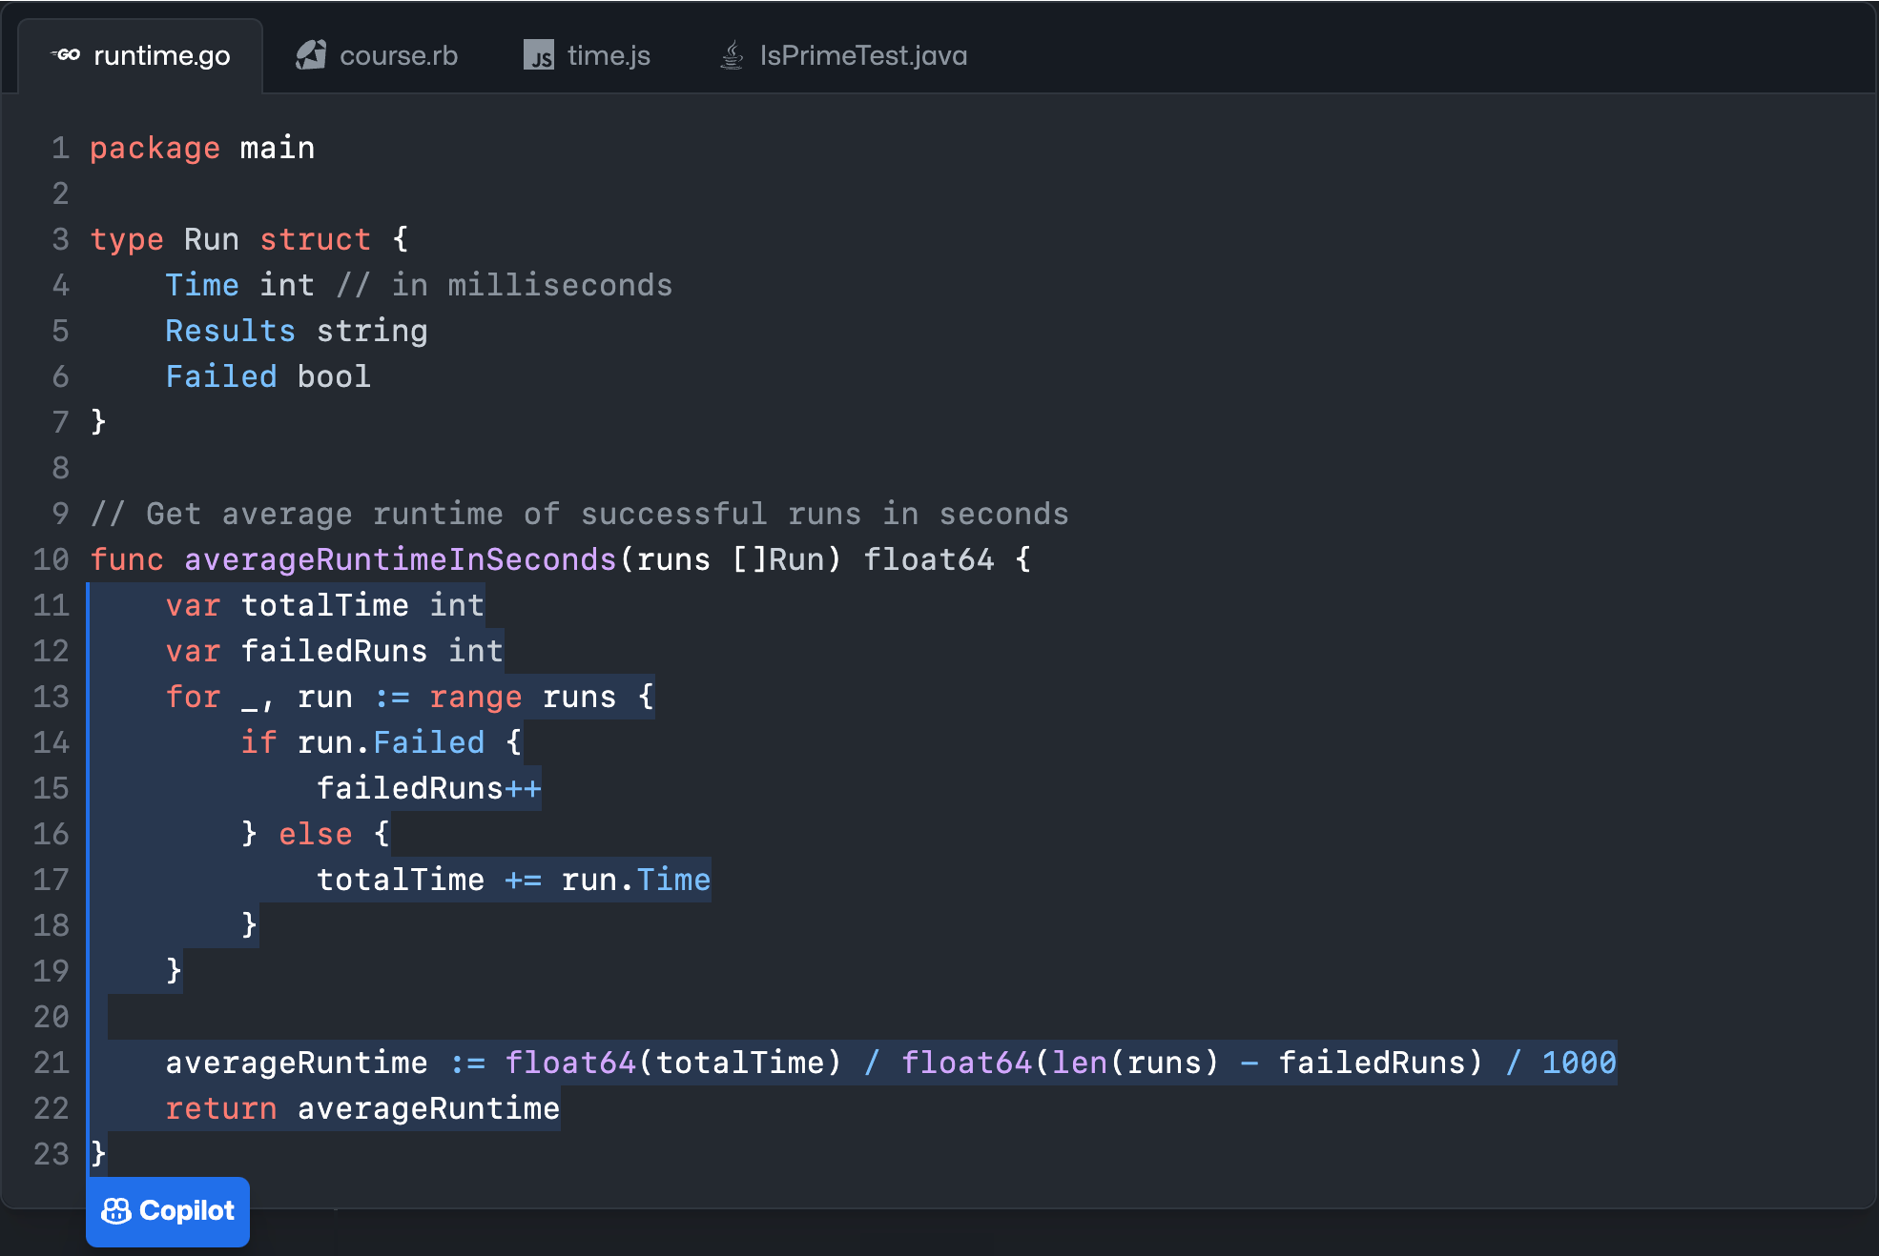
🕵️‍♀️ Measurement and Evaluation Experiences
Global Services Company:
Approach: Used Surveys with developers as they adopted Copilot to monitor impact.
Findings: ~20% self-reported time savings, higher for junior developers
Air Travel Company:
Approach: Evaluated Copilot within a small team.
Findings: ~60% self-reported time savings. Depleted their backlog very quickly and had to put the evaluation on hold.
Financial Industry Software Company:
Approach: Surveyed 100+ developers on time savings after 1 month of using Copilot
Findings: ~1.5 hrs of self-reported time savings per day collected weekly. Since Copilot only affects time spent coding, this metric limits the ability to understand day to day differences or how much coding time was saved as a percentage to enable calculation of economic benefit and process improvement impact.
Potential Risks and Mitigations
Survey fatigue - Rotate surveys across teams, keep them concise, do surveys temporarily, or as a ‘spot check’, share results.
Incorrect self-reporting - Use the quantification + validation approach to improve accuracy.
Change resistance - Involve teams early, incorporate feedback, share efficiency gain benefits by providing more discretion and options and ideas for how time is “spent”. (There is more to increasing impact than faster velocity!)
Once enabled…
Context
Suggestions
OpenAI Codex

Slide 30
🔬 Additional Survey Engine Details
The Survey Engine provides a lightweight way to gather quantitative reports from developers on their experience using Copilot. It uses a “a two-step quantification and validation approach”, similar to a tax return so that the quantified values reported can be confirmed and cross-checked.
The survey engine can be installed on any repository to automatically prompt developers, via an automatically created issue, to provide feedback on Copilot when they submit pull requests.
The survey engine asks questions like:
Did you use Copilot for this PR?
Compared to your previous experience coding WITHOUT using Copilot, How much less time did the coding take during this PR with Copilot?
Describe your thought process for calculating (or estimating) the time saved in the above question
How frequently did you use Copilot?
Is there anything else you want to document about your recent experiences with Copilot?
The responses can be saved to a private database for analysis. This allows compiling both quantitative and qualitative insights into the value of Copilot across the engineering organization.
Key benefits of the survey engine:
Lightweight integration using a GitHub app
Automatic prompting based on PR lifecycle
Customizable survey questions
Language detection to render surveys in user's preferred language
Backend storage of anonymized responses
The quantified efficiency gain measured via such questions complement usage analytics and clarify Copilot's benefits including efficiency gains, knowledge sharing, and onboarding improvements.

Slide 31
🔗 2-step Quantification & Validation Survey Technique Asking survey respondents to quantify information and then validate their responses is often referred to as “a two-step quantification and validation approach”.
Some key aspects of this survey technique:
Quantification Step - Asking the respondent to provide a numerical or quantified estimate in response to a question. For example: "What percentage of time did Copilot save you on this task?"
Validation Step - Follow up by asking the respondent to explain or describe how they arrived at the quantification. For example: "How did you estimate the time savings percentage you provided?"
Two-Step - Conducting the quantification and validation as two separate steps allows validating the accuracy of the quantification.
Accuracy - The combination aims to improve accuracy over single-step numerical questions.
So in summary, this technique is called two-step quantification and validation in survey methodology. The validation step is key for assessing the accuracy of the initial quantification provided.

Slide 34
While there are many ways to think about Copilot….
Pair Programmer 🤔
Expert System 👨🏾‍🏫
Code Translator 👓🩻
A Faster keyboard 🔥⌨️🔥
Notes:
It’s useful to realize that copilot is not ONE thing, and there are many ways it can be used and can help!

Slide 35
Speeding up Dev Task Completion is part of a “Cascade”
Adoption
Use Copilot’s Admin Page to Monitor “Assigned users” and their “Last Activity Date”
Activity
Use Copilot Telemetry to Monitor “Lines of Code Accepted” and “Suggestion Acceptance Rate”
Efficiency Gain
Use the “Survey Engine” to capture Dev Reported Time Savings by PR or by Week
Downstream Impact
Select and Monitor “Downstream Metrics” that Developers and Teams are intending to improve with Copilot. ⚠️
Notes:
All else being equal, time savings is an efficiency gain. Could all things NOT be equal? Yes, and we touch on some of them, but sophisticated or longer term impacts of the tool is outside of the scope of this presentation.

Slide 36
There is a growing number of metaphors for how to think about Copilot….
Pair Programmer 🤔🤔
Expert System 👨🏾‍🏫
Code Translator 👓🩻
A Faster keyboard 🔥⌨️🔥
A Predictive Model 🔮

